Slide 1
Review-2 on NutriNerve
<Medapati Harshitha Reddy> <2410030001>
<G Jahanvi> <2410030059>
<Rishika.T> <2410030122>
<Surabhi Sarda > <2410030123>
Under the Guidance of
<Shahin Fatima>
<Course Coordinator>
Computer Science and Engineering Department
KL Hyderabad Off Campus, Aziz Nagar ,Hyderabad

Slide 2
Overview
Introduction
Objectives of the Project
Literature Review
Proposed Methodology/Architecture/Algorithm/Technique/etc
Design (diagrams)
References

Slide 3
Introduction
Healthcare is shifting from reactive treatment to proactive and preventive care.
Massive amounts of data are generated from medical records, diagnostics, wearables, and lifestyle inputs.
There is a strong need for intelligent systems to turn this raw data into actionable health insights.
Nutri Nerve – Smart Healthcare Analytics is a data-driven platform designed for predictive insights and personalized recommendations.
It leverages data analytics, machine learning, and visualization tools to provide a comprehensive solution.
The ultimate goal is to empower individuals with personalized diets, risk detection, and early health interventions.

Slide 4
Objectives of the Project
Early Risk Detection – Identify potential health issues using predictive analytics and machine learning.
Personalized Recommendations – Provide tailored diet plans and lifestyle suggestions based on individual health data.
Smart Visualization & Insights – Deliver interactive dashboards and reports for patients and healthcare providers to support informed decision-making.

Slide 5
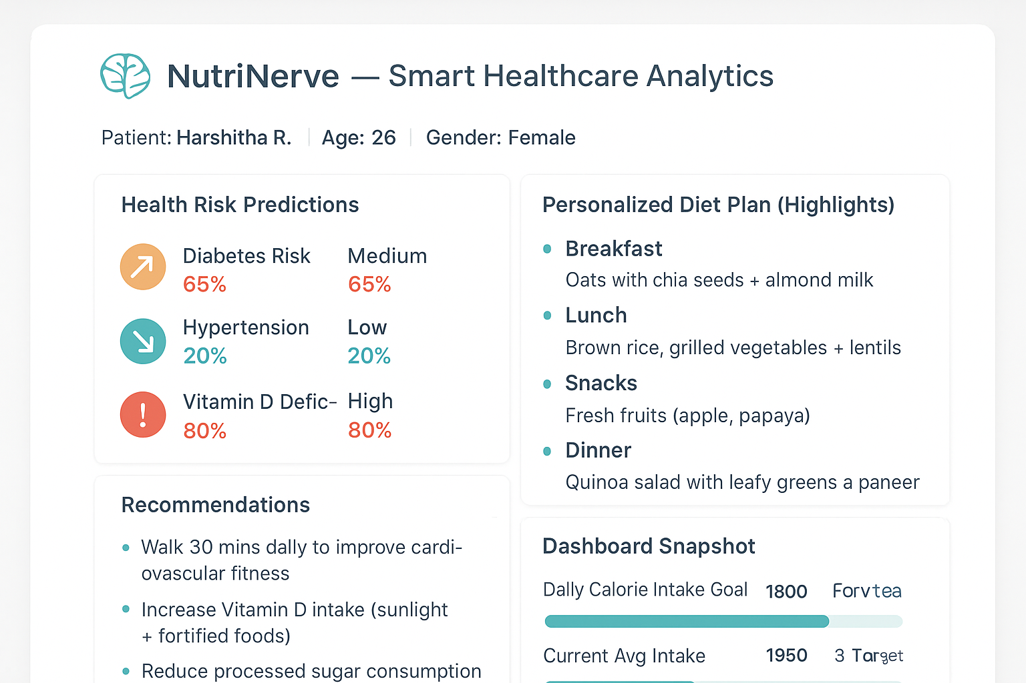
Designs
Patient: Harshitha R. | Age: 26 | Gender: Female
📊 Health Risk Predictions
Diabetes Risk: Medium (65%)
Hypertension Risk: Low (20%)
Vitamin D Deficiency Risk: High (80%)
🍽 Personalized Diet Plan (Highlights)
Breakfast: Oats with chia seeds + almond milk
Lunch: Brown rice + grilled vegetables + lentils
Snacks: Fresh fruits (apple, papaya)
Dinner: Quinoa salad with leafy greens and paneer
💡 Recommendations
Walk 30 mins daily to improve cardiovascular fitness
Increase Vitamin D intake (sunlight + fortified foods)
Reduce processed sugar consumption
📈 Dashboard Snapshot
Daily Calorie Intake Goal: 1800 kcal
Current Avg Intake: 1950 kcal
Water Intake: 2.5L / 3L target

Slide 6
References
Computational intelligence in neuroinformatics: Technologies and data analytics -- Anand Deshpande ,Vania Vieira Estrela Jude Hemanth , Anitha Jude
Personalized Nutrition Recommendations for Arab Communities: Transforming Diet and Health through Machine Learning -- Khalfan Aldoobi
Voice Assistants For Health Self-Management: Designing For With And With Older Adults -- Amama Mahmood
The Impact of Big Data on Predictive Analytics in Healthcare -- Muhammed Busari

Slide 7
Thank you and Any Queries

